Slide 1

Training Room
AV System Use Instructions

Slide 2
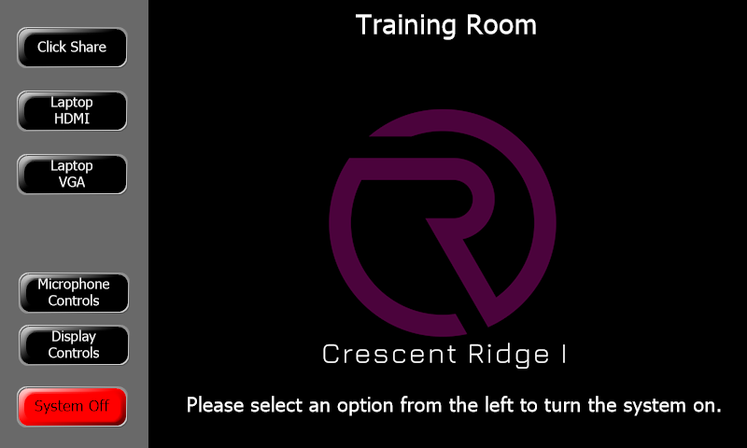
Home Page
This screen is displayed when the system is turned off. Selecting an option from the left will begin the system start up routine,

Slide 3
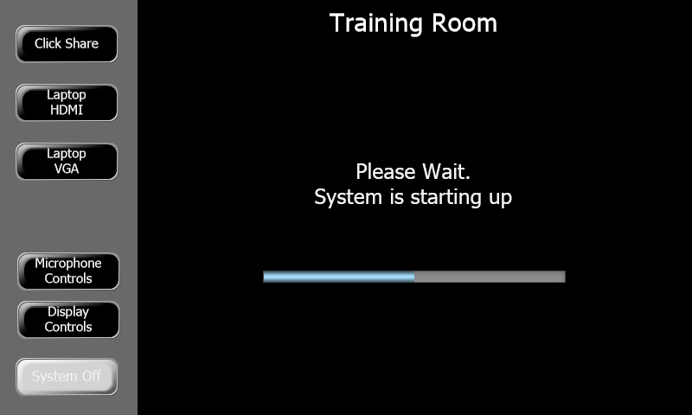
System Starting Page
This screen is displayed while the system is starting up. Note “System Off” button is now gray indicating the system is no longer in the off mode. Note the progress bar will reflect the time remaining for the system to finish starting up.

Slide 4
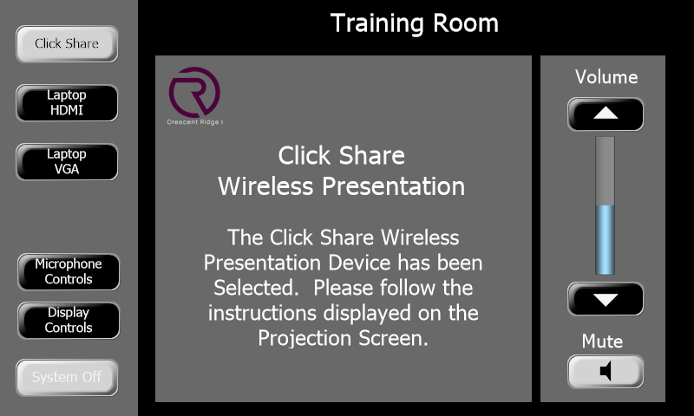
Click Share Page
When the “Click Share” is selected as the source this page will be displayed. Note the “Click Share “ button is now light gray to indicate that it has been selected. The volume and mute controls at the right will adjust playback volume of any media that is displayed.

Slide 5
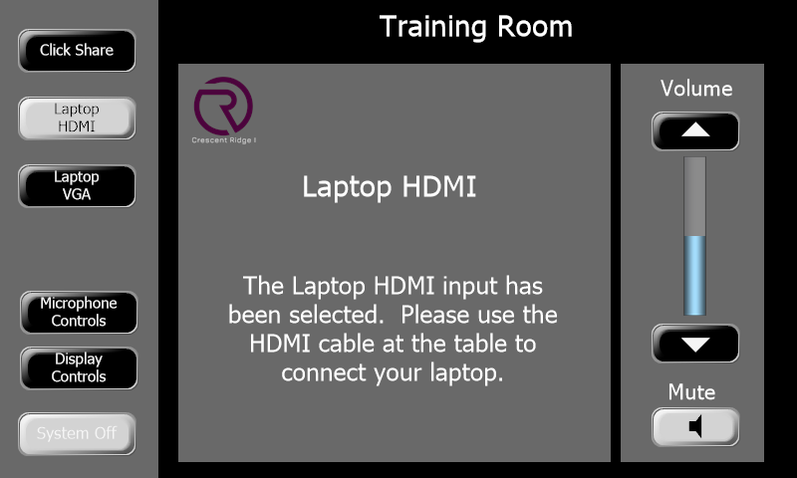
Laptop HDMI Page
When the “Laptop HDMI” button is selected as the source this page will be displayed. Note the “Laptop HDMI“ button is now light gray to indicate that it has been selected. The volume and mute controls at the right will adjust playback volume of any media that is displayed.
.

Slide 6
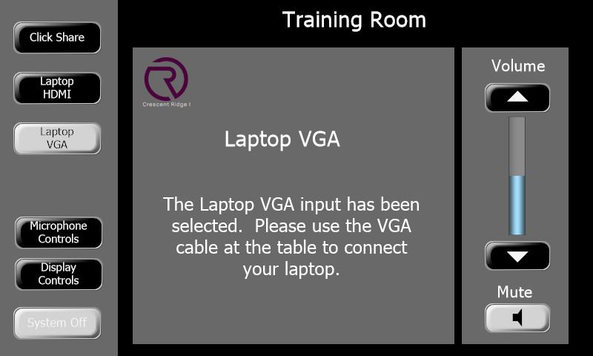
Laptop VGA Page
When the “Laptop VGA” button is selected as the source this page will be displayed. Note the “Laptop VGA“ button is now light gray to indicate that it has been selected. The volume and mute controls at the right will adjust playback volume of any media that is displayed.

Slide 7
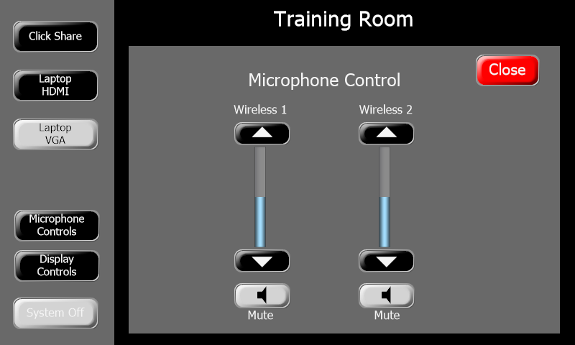
Mic Control Page
The “Microphone Controls” button will bring up this page. Here you can adjust the levels of the two wireless microphones. The “Mute” buttons will turn to red when the microphone has been muted. Selecting the “Close” button will close the window and return to the previous screen.

Slide 8
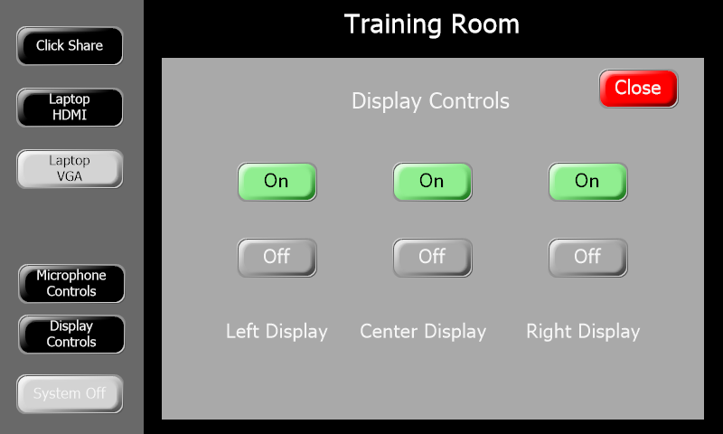
Display Controls Page
Selecting the “Display Controls” button will show this page. Here you can turn on or off the individual displays. The “On” buttons are green when the power to the display is on. The “Off” button is red when the display has been turned off. At start up all three displays will be turned on. At shut down all three displays will be turned off.

Slide 9
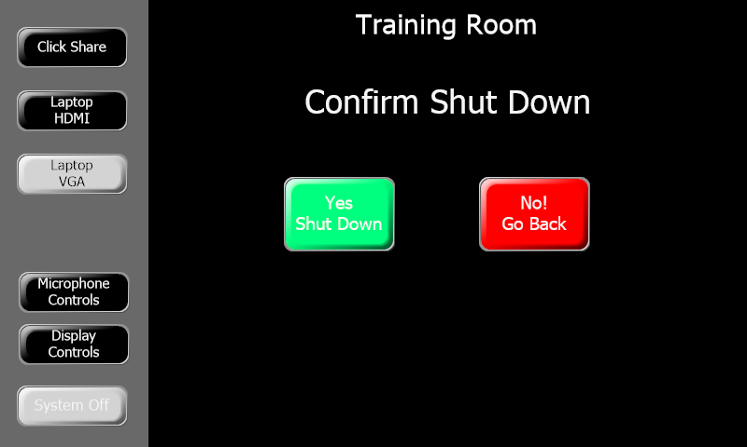
Shut Down Confirmation Page
When the “System Off” button has been selected this screen will display to allow the user to confirm or cancel the shut down process. Pressing “Yes, Shut Down” will begin the system shut down routine. Pressing “No! Go Back” will cancel shut down and return the user to the previous screen.

Slide 10
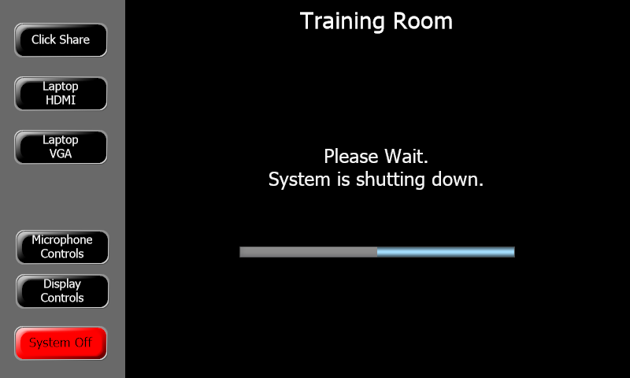
Shutting Down Page
This screen will display while the system is shutting down. Note the progress bar will reflect the time remaining for the shut down to finish.

